Slide 1
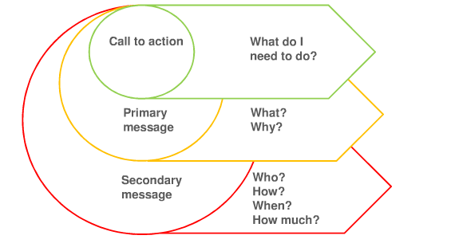
eBay Bucks messaging hierarchy

Slide 2
List and prioritize
Define and prioritize messages with stakeholders
(Remember, messages are not final user-facing content, but high-level messages)
eBay Bucks Messages
Primary:
It’s free
It’s easy
It has real value
We are glad you’re here and that you chose eBay
Understand how the program works
Secondary:
You don’t need to do anything other than sign up
We are not like other rewards programs you’ve experienced (and forgotten)
We want you to win.
Understand the percentage of earn
Understand that some products are not eligible
Understand that eBay is paying for and providing this benefit
Understand that eBay will do all the heavy lifting
Understand that it is different from other rewards programs
We won’t spam you

Slide 3
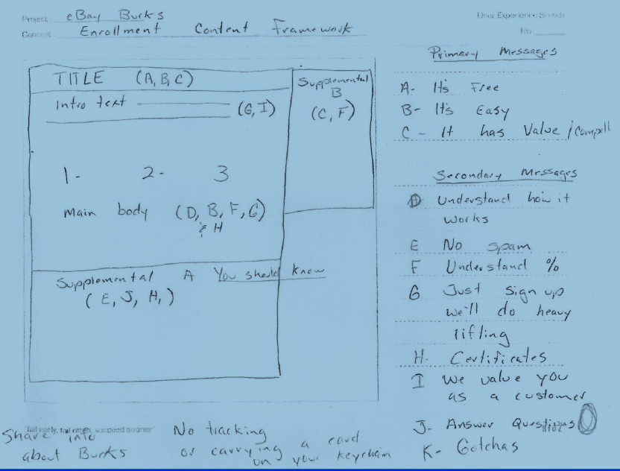
Map messages
Map messages to page

Slide 4
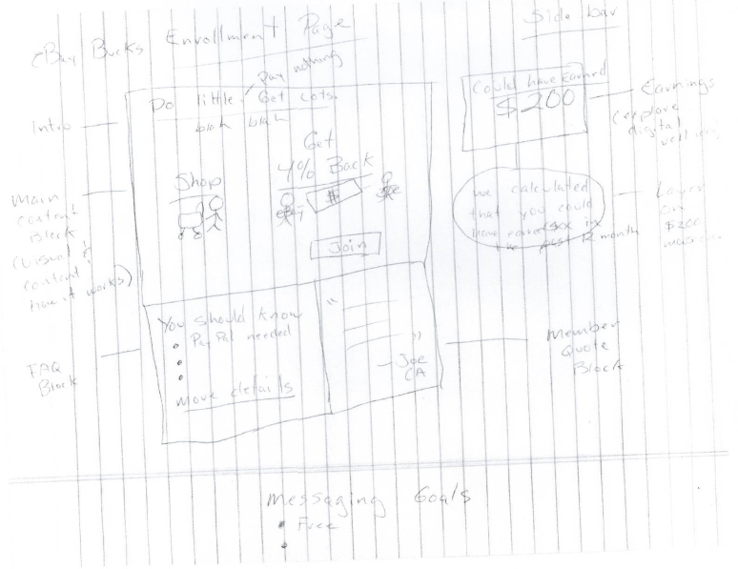
Add visual elements
Sketch with visual ideas for more specific message mapping

Slide 5
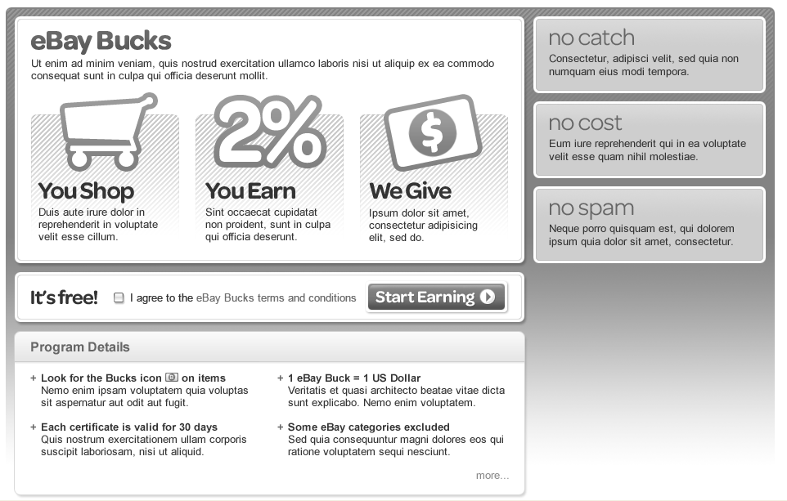
Place in framework
Work with interaction designer to place high-level messages and preliminary labels into framework
(Notice that “content” is not on the page yet--just key messages )

Slide 6
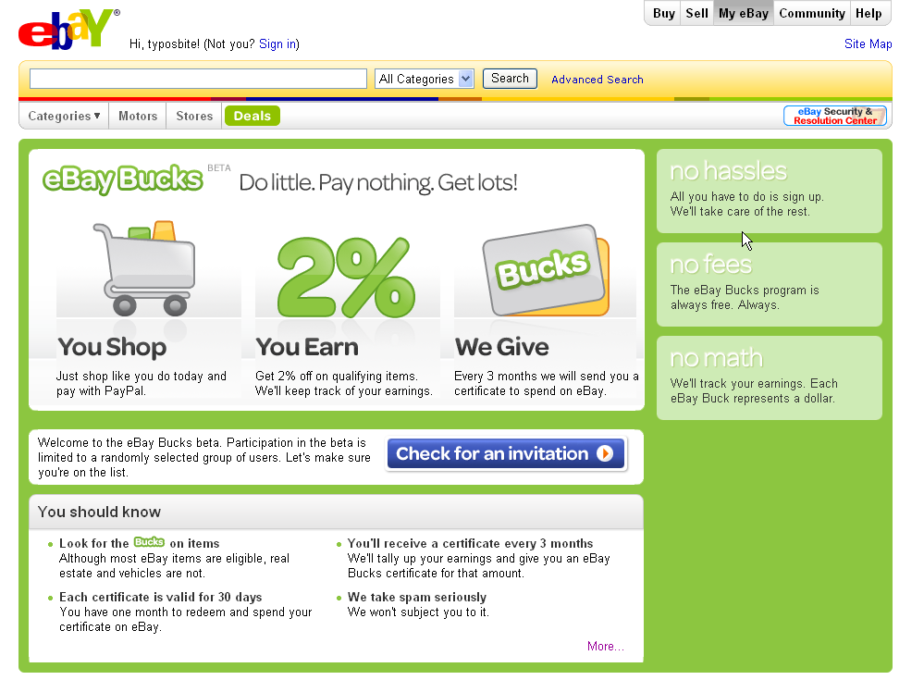
Add final content and visuals
Create final content and visuals that adhere to, and enhance, your messaging hierarchy

