Slide 1


SOS Content Guidelines
DeAnn Wright
April 1, 2016

Slide 2


WHAT MAKES A
GREAT EMAIL?
COMPONENTS OF
AN EMAIL
CONTENT AND TONE
OF VOICE GUIDELINES

Slide 3
WHAT MAKES A GREAT EMAIL?

Slide 4
A GREAT EMAIL . . .
Places the reader at the center of everything.
Shows empathy and understands the context.

Slide 5
Three questions every great email must answer:
WHY DID I RECEIVE THIS EMAIL?
HOW IS THIS EMAIL VALUABLE TO ME?
WHAT SHOULD I DO NEXT?
Answering these questions will provide context for readers. It will help us simplify our emails and be more precise in how we communicate with our customers. And that makes for a great email.

Slide 6
COMPONENTS OF AN EMAIL

Slide 7
ABOUT COMPONENTS
Email components need to work together as a system, with each piece building on that of the one before it.
Design and content have to work together to create components that will help people understand the purpose of the email, and what they need to do next
Stakeholders should identify the key messages they want to communicate in the email. These messages can then be mapped to the email components.

Slide 8

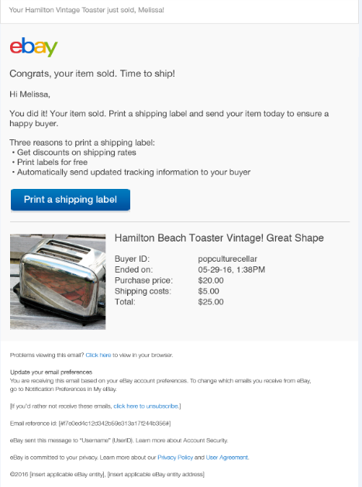
PRE-HEADER
TITLE
BODY
CTA
FOOTER

Slide 9
SUBJECT LINES
It all starts with the subject line. This is where a reader decides to engage with the email. Get it wrong, and your email won’t get opened.
GUIDANCE | EXAMPLE
Subject lines appear in the reader’s inbox. They need to be very short and compelling to entice the reader to open the email. When creating subject lines, keep in mind that only the first 30 characters will show. Put the most important information first to make these easy to scan. | You sold an item

Slide 10
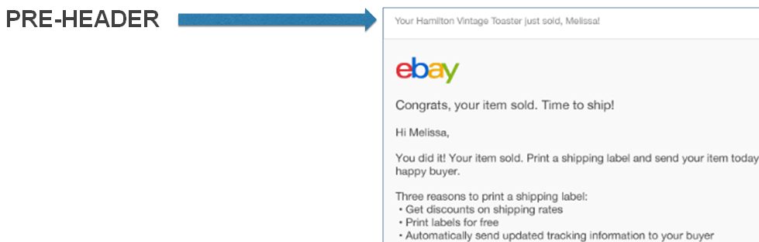
PRE-HEADERS
Next comes the pre-header. This little line may look like an afterthought in a Web browser, but it’s hugely important on mobile devices.
GUIDANCE | EXAMPLE
Pre-header text shows up under the subject line and is used by mobile devices to show the user what the email is about. Needs to be fairly short. Can include personalization. | Your <item name> just sold, <first name>! or Your iPhone 6s just sold, Ben!

Slide 11
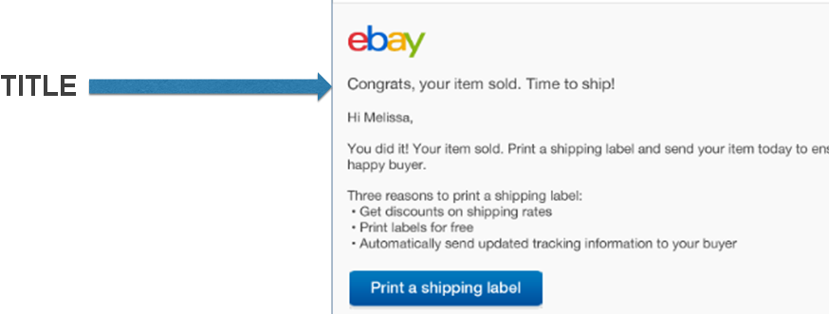
TITLES
Critical to get right, titles distill the idea of the entire email into one single thought. In some emails, the title will be direct. In others, it will be a chance to create a moment of connection with the reader.
GUIDANCE | EXAMPLE
The title is the first line a user sees when they open the email and is sometimes all they read. Needs to work in conjunction with the CTA. | Congrats, your item sold. Time to ship.

Slide 12
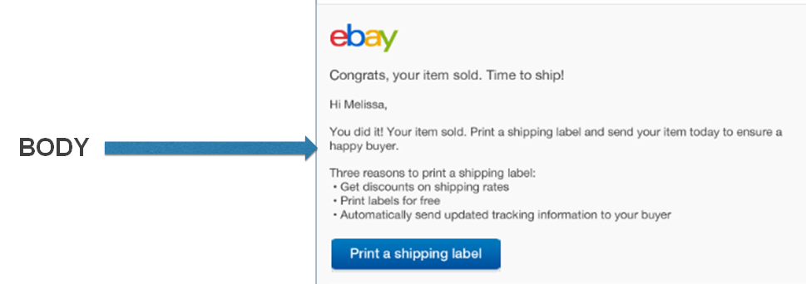
BODY CONTENT
The body of the email is where they get the details. As always, be as brief as you can without sacrificing accuracy and clarity.
GUIDANCE | EXAMPLE
Try to keep this short as well, but this is where you can place any additional information they need to decide if they should take action on this email, and why. Since there’s a little more room, you can inject a bit of humanity here. Include a salutation. | Hi <first name>, You did it! Your item sold. Print a shipping label and send your item today to ensure a happy buyer. Three reasons to print a shipping label: Get discounts on shipping rates Print labels for free Automatically send updated tracking information to your buyer

Slide 13
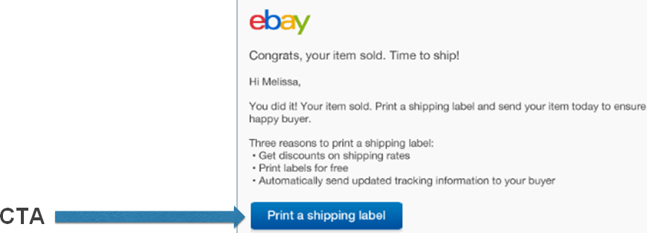
CALLS TO ACTION
To create effective CTAs, you need to understand the flow of where someone was when they received this email, and where they’re going when they complete the call to action. And you need to clearly communicate that in the button itself.
GUIDANCE | EXAMPLE
CTA text appears on the button. Needs to be short and compelling, keeping in mind other languages. No more than 2-3 words. | Pay now

Slide 14
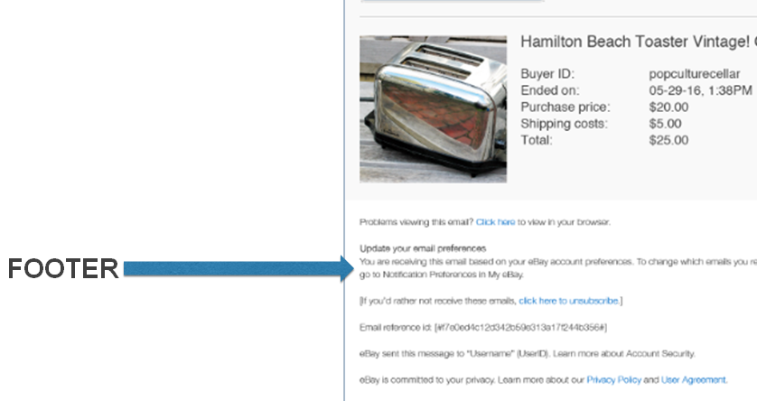
FOOTERS
Each email contains information that needs to be there primarily for legal reasons. It’s important that we use the right footer. We will not be creating unique content for each email footer. We’ll choose the appropriate one from a list of pre-approved footers.
GUIDANCE | TYPES
Content for all footers is approved by legal. Do NOT create content for these. Select one from the list. | Optional: User can opt out of receiving this email Non-optional: User cannot opt out of receiving this email

Slide 15
GUIDELINES FOR WRITING

Slide 16
THE BASICS
Be clear. No matter how complicated an idea or policy is, we have to tell people about it in the simplest way possible. If they need to do something with the email, be clear about what that is and what will happen when they do it.
Be conversational. Good writing should sound the way people – or at least intelligent people – talk. It should be appropriately informal and familiar.
It’s not about you. Putting some personality into the copy is important. Adding a little wit and charm is normally a good thing. But it’s like salt. A sprinkling here and there can make things more enjoyable. Use too much, and you’ll make people gag.

Slide 17
STYLE GUIDELINES

Slide 18
STYLE GUIDELINES
Emails should follow the eBay style guide.
All emails need a subject line (what shows in inbox) a line of pre-header text (for mobile devices), a title, and a CTA button.
Say one thing at a time. Pay attention to your agreed upon messaging hierarchy, and don’t put too many thoughts in the same line.
Email content should complement and be consistent with the product flow. Do not introduce a new concept in an email. Emails should also use the same terminology as the product flow. For example, if the product pages say “return number” do not say “return ID” in the email.

Slide 19
STYLE GUIDELINES
Emails should be as short as possible. Keep in mind that users typically scan the title and button. Tell them what happened, and what they need to do next, as succinctly as you can.
Do not include “eBay” in the subject line. Exception is if “eBay” is part of a feature name.
Use sentence case on subject lines, titles, pre-header text, and buttons.
Follow eBay style guidelines for use of “sorry” and “congratulations.” Do not use congratulations for getting through an eBay process. Consider “Good news,” “Welcome,” or “Thanks”.
Do not use a closing (i.e. Thanks, eBay). Research has shown that this actually confuses some users.

Slide 20
VOICE AND TONE GUIDELINES

Slide 21
VOICE AND TONE GUIDELINES
Our voice is clear, concise, and conversational.
We speak to our customers in a natural and purposeful way. This means we use contractions and an informal style.
We use active voice, whenever possible. There may be some exceptions for CS emails where we want to avoid blame.
To be conversational, we speak in the first person. This means we use “we” and “you,” wherever appropriate.
To be friendly and informal, we use “Hi” instead of “Dear” in the salutation. For the US, salutations should also use the user’s first name.

Slide 22
VOICE AND TONE GUIDELINES
We are not stiff or institutional. We are open and accessible.
We have no need for jargon or corporate speak. Just because you know what a term means, please don’t assume anyone else does.
We are smart, honest, and trustworthy in our communications. When things go wrong, we take blame if it’s our fault.
We show empathy and want our customers to feel confident, engaged, and informed.
Always consider the customer’s emotional state. What do we want them to know, feel, and do? Although our voice doesn’t change, we do adapt our tone to the customer’s feelings.

Slide 23
VOICE AND TONE GUIDELINES
Context is everything. For example, if the seller hasn’t received payment, we may adopt a more direct tone to tell them what happened and what they need to do next. If the buyer won an auction, we may use a friendlier, somewhat more fun and congratulatory tone.
We believe that people are basically good. We do not assume that people intentionally did something wrong. Because of that, we do not use a paternal tone or point fingers when someone makes a mistake.

Slide 24
OUR VOICE ATTRIBUTES
We ARE | We are NOT
Dynamic Our voice is active and positive. | Static Our voice is not formal, cold, passive, or stilted.
Human and approachable Our voice is friendly and helpful. We’re empathetic and honest. | Off-putting Our voice is not pushy, aggressive, overly clever, negative, cryptic, or fake.
Smart and trustworthy Our voice is insightful and personalized. We give you a clear, well-lit path. | Arrogant Our voice is not condescending, patronizing, presumptuous, or insensitive.
Inspiring Our voice is uplifting and engaging. We connect you to your dreams. | Eccentric or unattainable Our voice is not weird, quirky, or over the top. We are also not overwhelming, flat, or routine.

Slide 25
VOICE ATTRIBUTES: EXAMPLES
DYNAMIC is | DYNAMIC is NOT
To help keep you safe, we need you to update your password. | We’re writing to let you know that we require you to update your password at this time.
APPROACHABLE is | APPROACHABLE is NOT
Here’s how it works. Don’t worry—we’ll guide you every step of the way. | You shouldn’t have bought an item from a seller with less than 100 feedback. You can only return an item if the seller lets you.
HUMAN is | HUMAN is NOT
Oops! Did you forget to pay for your Gucci wallet? We understand you’re probably busy, but the seller can’t send it to you until you pay. And we don’t want that to happen. Pay today so you can get it soon. | Warning: eBay requires that buyers remit payment for items within 48 hours of purchase. Failure to pay may result in an account suspension.
SMART is | SMART is NOT
Purchase not perfect? Getting a refund is a simple. Here’s what you need to do: 1- Send it back to <seller name> with our easy return label 2- Get money in your PayPal account | Dear valued member, Are you sure you want to return this item #2456759706? The item must be returned to the seller before a refund can be issued to the buyer.
INSPIRING is | INSPIRING is NOT
What to know what’s hot for spring 2016? Let our style director point you to the trends that everyone will be wearing this season. Love Prada shoes? Into Chanel handbags? Yeah, we have those. | Buyers can choose from more than 400 million items from a broad range of categories.

Slide 26
Context is everything

Slide 27
To determine the appropriate tone of voice consider the reader’s emotional state.
What situation is the reader in that triggered this email?
How does the reader likely feel when they receive this email?
How will this email make the reader feel afterwards?

Slide 28
A few examples

Slide 29
Situation/Trigger | Reader’s state of mind | Voice and tone considerations | Content examples
Account suspended | Angry, confused, helpless, WTH? | Be direct and straightforward, show empathy, be calm and clear on what to do next | We’ve temporarily suspended your account. To continue bidding on items, you’ll need to pay for your past purchases.
Account takeover | Upset, fearful | Show empathy and confidence, build trust, not their fault, we can help | Looks like someone tried to use your account. Don’t worry, we’ve got you covered, Ben. Just reset your password so it won’t happen again.
Won an auction | Surprise, joy, delight | Celebratory and fun tone | It’s all yours. We hope you love your new purchase.
Sold an item | Happy, pride, curious | Celebratory and direct on what they need to do next | You did it. Someone just bought your <xxx>. Ship quickly as soon as they pay.
Outbid | Nervous, frustrated, annoyed | Calm and helpful. We can help them win | Don’t let it get away. Someone out bid you. Bid again.
First time listing | Nervous, excited | Reassuring and helpful | Way to go, George. You’ve listed your <xxx> on eBay, and you’re on your way to becoming an eBay seller. Once it sells, ship quickly to keep your buyer happy,
Buyer hasn’t paid | Nervous, annoyed, reactive, frustrated | Positive and reassuring, set realistic expectations, what to do next | It’s possible the buyer just got busy or forgot to pay. We’ll send them a reminder for you.

Slide 30
You can’t hit every voice attribute in an email. Nor should you try. Voice attributes should be dialed up or back depending on the context.
Email type or audience | Key Voice Attributes
 | Dynamic | Human & Approachable | Smart & Trustworthy | Inspiring
Buying/Shopping | Secondary | Primary |  | Primary
Casual and first-time sellers | Primary | Primary | Secondary | Primary
Business sellers |  | Secondary | Primary
Resolutions |  | Secondary | Primary
Identity and Trust | Secondary | Primary | Primary
Seller success | Primary | Primary |  | Secondary
Bidding/Outbid | Primary | Secondary | Primary
CS/Policy Compliance |  | Primary | Primary

Slide 31
Don’t confuse our values with our voice.

Slide 32
You’ll notice we didn’t say our writing should be bold. Or courageous. Or any of the other things listed in our values. That’s because our values are just that. Our values.
They should be visible in our actions, not in our tone of voice. And they should guide what we do, not how we talk about ourselves.
So let’s be bold. Let’s be courageous. Let’s create emails that are actually helpful. That tell people exactly what they need to know. And do it in a way that values that person’s time and mental bandwidth.

Slide 33
CUSTOMER SUPPORT GUIDELINES

Slide 34
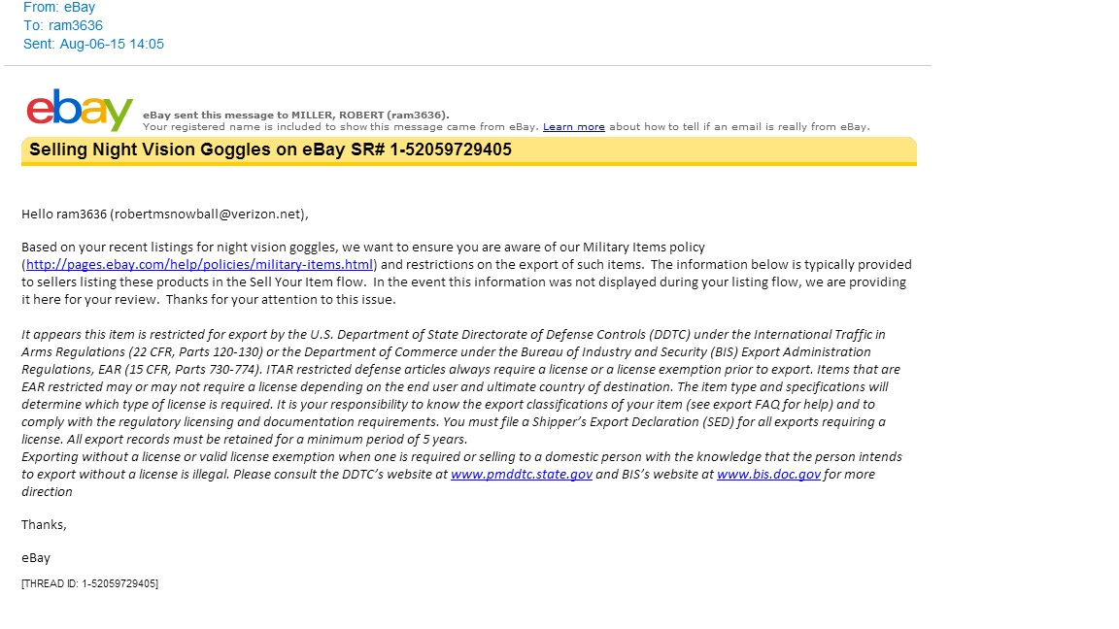

PARTS OF A CS EMAIL
SUBJECT
GREETING
BODY
CLOSING TEXT
- Subject: Use general email guidelines. If space is an issue, put “eBay” at the end, or don’t use “eBay” at all.
- Body: Use general email guidelines. However, CTA is a hyperlink with preceding explanatory text.
- Closing: Unlike the general email guidelines, CS emails should use a closing (i.e. Thanks, eBay).
- Other important guidelines: See CS emails Project SOS Wiki for process, style guides, and other resources.

Slide 35
WRITING FOR POLICY
Consider the customer context, and use this context to help form the level of detail that is provided.
Consider:
  What are the implications for the read not taking action? Specify this in the email.
  What actions does the reader need to take? How? Specify this in the email. If no action is needed, state this.
  What experience does the reader have? What are the possible scenarios for the reader? Consider what needs to be added to the email in this context.

Slide 36
Thanks.

Slide 37
REFERENCES
US Product Style Guide
https://wiki.vip.corp.ebay.com/display/UEDCSTRAT/eBay+Marketplaces+style+guide+directory

