Slide 1
Content strategy for new WebNext landing page
DeAnn Wright: Lead Content Strategist
Sept. 27, 2012

Slide 2
Objectives
Inform, set expectations, motivate (in a fun and friendly way), and create trust leveraging multimedia for new sellers to have not only a completed listing but an overall successful selling experience
Clean, modern, compelling landing page with as much as information as new sellers need all without ever leaving the page.
Content will be friendly, conversational, motivational, informational and provide clear guidance
Clean graphical representation showing the listing process

Slide 3
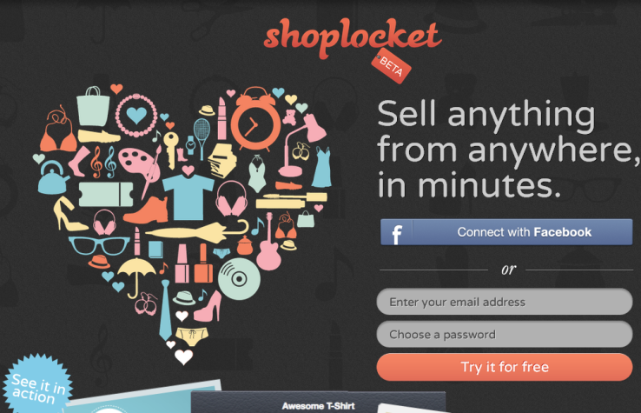
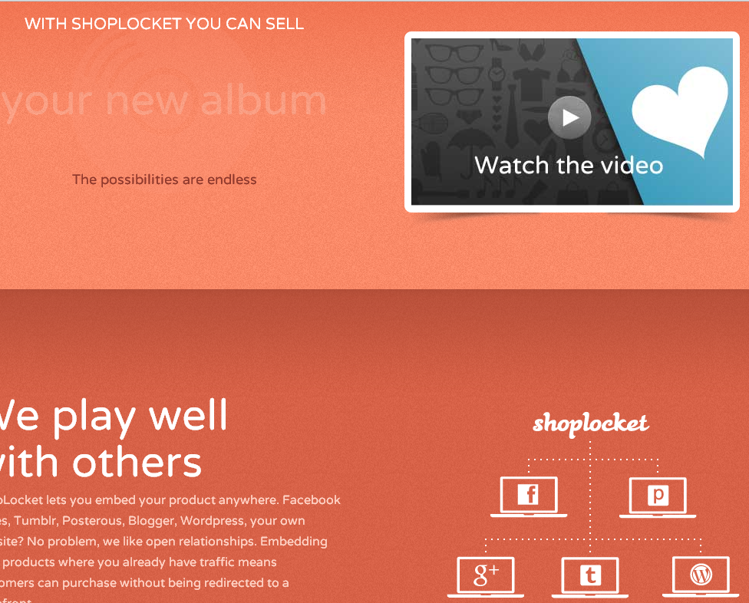
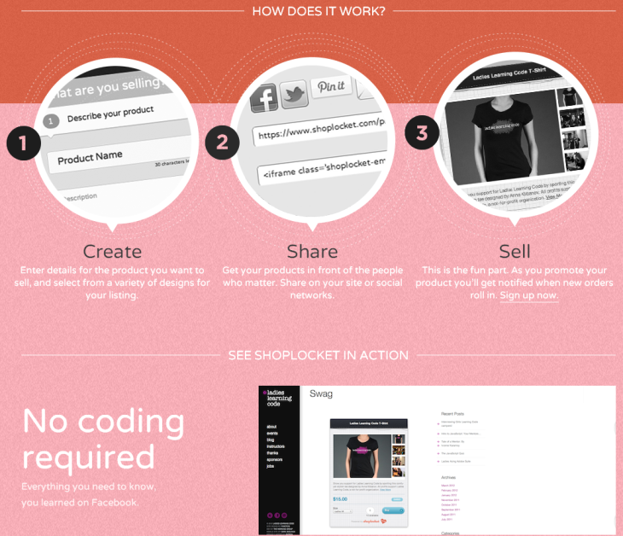
Competitive Analysis: Shoplocket
Light and fun, conversational style
Focus on variety of items you can sell
“It’s easy, we’ve got you covered”
Fun video that matches style of landing page

Slide 4
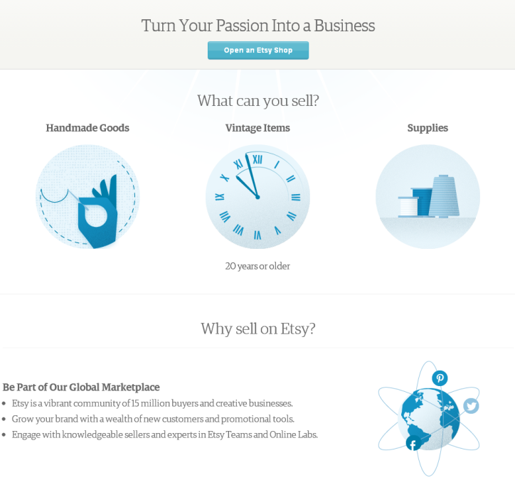

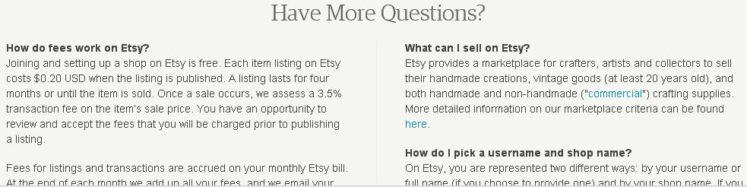
Competitive Analysis: Etsy
Focus on showing the variety of stuff you can sell on Etsy
Conversational style
Differentiators are feeling a sense of community and expression, while still making money
No videos

Slide 5
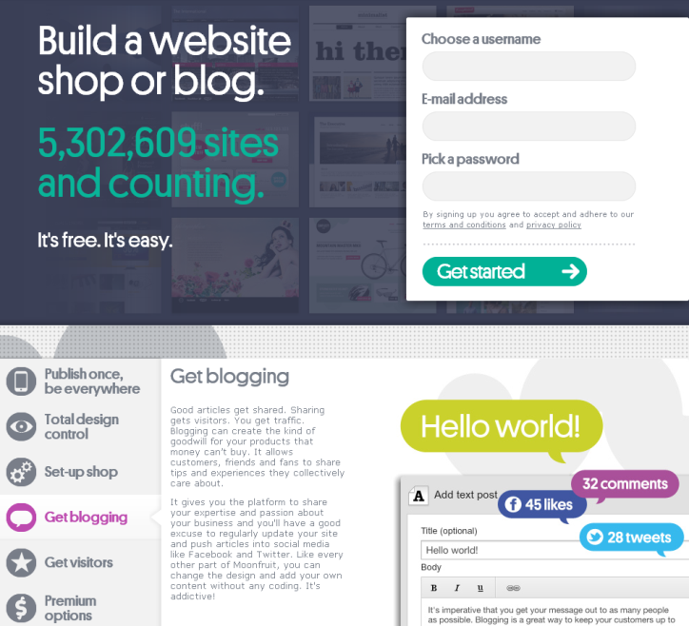
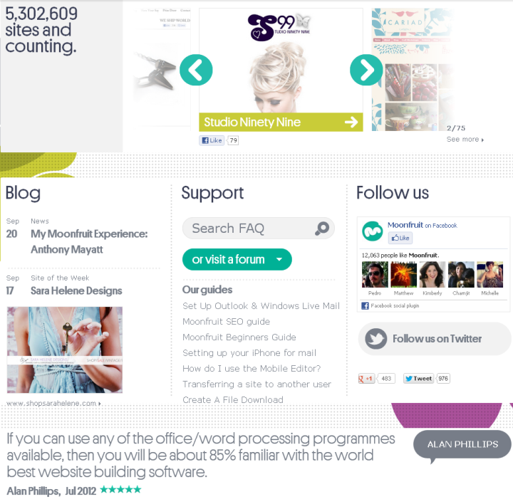
Competitive Analysis: Moonfruit
Focus on letting your inner designer design a store front with their help
Uses lots of infographics
Includes customer success stories
Video is cute but maybe a bit long

Slide 6
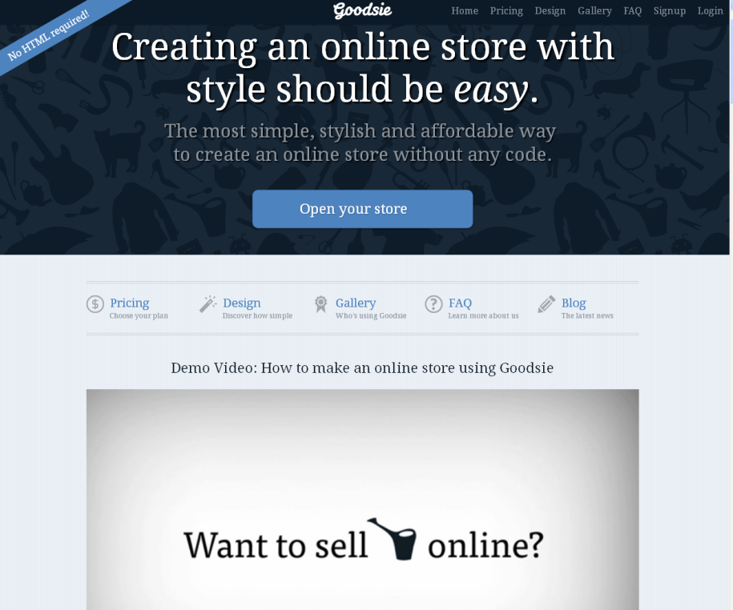
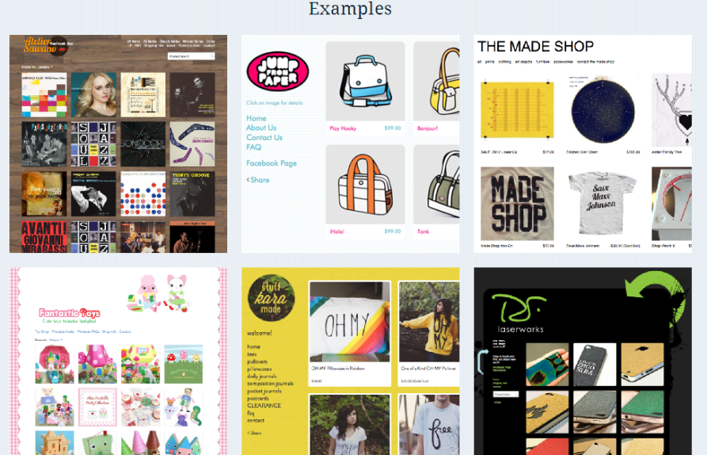
Competitive Analysis: Goodsie
Focus on creating an online store
Lots of examples
Lots of movement and animations
Uses press clippings instead of customer testimonials
Video is super fast

Slide 7
Guiding principles
Principle | Strategy
Inspire and engage new sellers | Show them what they can sell and how much they can make. Include customer testimonials.
Educate new sellers on how to list in a fun and friendly way | Keep step lists light and short. Include fun and educational video. Provide right level of guidance-enough to engage them without being overwhelming.
Show benefits of selling on eBay | Show what is about eBay that makes us unique and why we’re the best channel for selling their stuff

Slide 8

Voice and tone
Overall voice will be active and use 2nd person pronouns, “You” and “We.”
Overall tone will be conversational and friendly.
Content type | Primary attributes
 | Inspiring | Approachable | Smart | Authentic | Dynamic | Friendly/Human
Headline/sub-head
Infographics
Testimonials
Steps to list
FAQs
Tips and hints
Why sell on eBay
Contact us
Video script

Slide 9
Messaging hierarchy
Key messages:
Selling is easy and you can make money
You can list anything, from anywhere
Get inspired by others and what’s selling on eBay
eBay is a great place to sell stuff.
We’ve got you covered. We’re here to help. We’ll guide you through it.

Slide 10
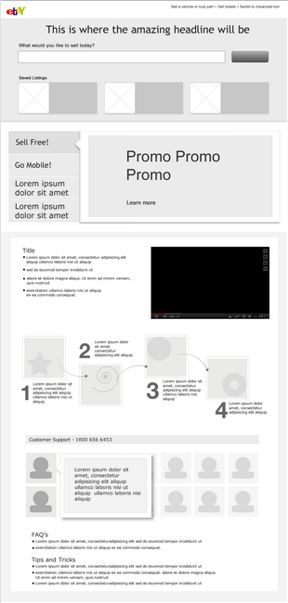
Framework 1: with messaging hierarchy
Selling is easy and you can make money
You can list anything
Get inspired by others and what’s selling on eBay
eBay is a great place to sell stuff
You can list anywhere
We’ve got you covered. We’re here to help. We’ll guide you through it

Slide 11
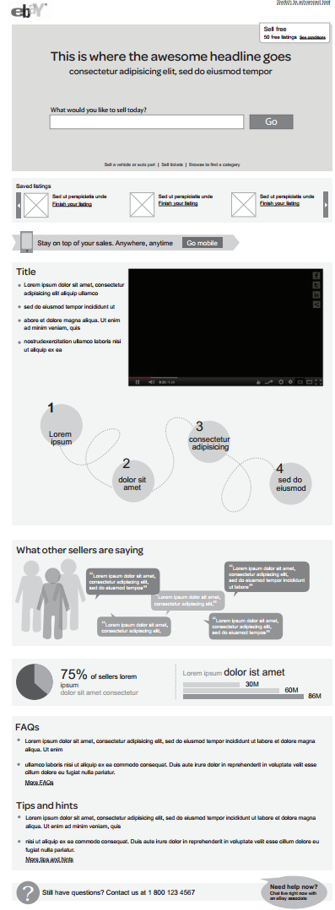
Framework 2: with messaging hierarchy
Selling is easy and you can make money
You can list anything
Get inspired by others and what’s selling on eBay
eBay is a great place to sell stuff
You can list anywhere
We’ve got you covered. We’re here to help. We’ll guide you through it

Slide 12
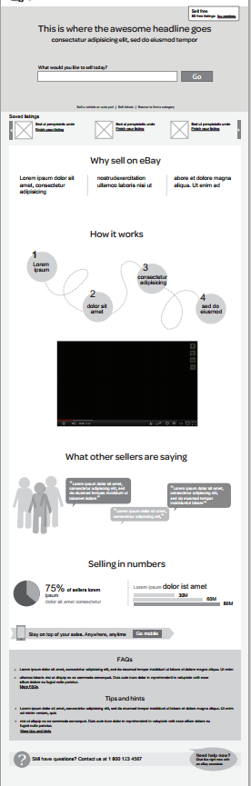
Framework 3: with messaging hierarchy
Selling is easy and you can make money
You can list anything
Get inspired by others and what’s selling on eBay
eBay is a great place to sell stuff
You can list anywhere
We’ve got you covered. We’re here to help. We’ll guide you through it

Slide 13
Content (Headline)
Rotating banner #1 (Sell anything)
Head: You can sell anything on eBay
( “anything” rotates between books, electronics, clothes, shoes, toy trains,DVDs, antiques, video games, bikes, scuba gear, teddy bears, cell phones, guitars, cameras, baby clothes)
Subhead: Turn your stuff into cash

Slide 14
Content (Headline)
Rotating banner #2 (Time and Ease)
Head: Selling on eBay is easier than you might think!
Subhead: And we’ll help you every step of the way.

Slide 15
Content (Headline)
Rotating banner #3 (Donate)
Head: Make extra money for your favorite cause
Sub-head: Turn your stuff into a cash donation

Slide 16
Content (Headline)
Rotating banner #4 (Money)
Head: Turn your stuff into cash
Sub-head: List anything. Pay nothing until it sells.

Slide 17
Content (Headline)
Rotating banner #5 (Eyeballs-Inspiration)
Head: List your stuff in front of over 100 million buyers.
Sub-head: eBay, it’s where the buyers go!

Slide 18
Content (Why sell on eBay)
Why sell on eBay
Free and EASY to list. No upfront fees. Free to list, free to add photos. You only pay when you sell.
Make real MONEY. Listing your stuff on eBay is the smart way to make extra money. Lots of folks are making a good living just by selling on eBay. You could be next!
We have LOTS of buyers. We have millions of interested buyers just waiting for you. “eBay”. . . perhaps you’ve heard of us? We’re the first place people go to buy stuff online.

Slide 19
Content (Step list)
List in 3 quick steps
Describe it and add photos. Start by simply telling us what you’re selling. Then, make your listing really shine with great photos. You can add up to 12 for free.
Choose your price and shipping. We’ll give you tips on how to price and ship your item. Most new sellers list their items as auctions to attract the most buyers.
List it. That’s it! Just click “List it” and your item will be visible to millions of buyers! Once it sells, tada, you get money!

Slide 20
Content (Testimonials)
The straight scoop
Don’t just take our word for it. Here’s what other sellers are saying.

Slide 21
Content (Infographics)
Title: Selling by the numbers
5,000,000
Items sold every hour on eBay (yours could be next!)
800,000
Active sellers (we’d love to add you to this number!)

Slide 22
Q&A
We rounded up some questions other seller friends have asked us.
Q. I’m pretty busy. How long will it take me to get my stuff up on eBay?
A. We realize you want to sell your stuff right now. Our quick listing tool makes selling on eBay easier than ever. We’ve simplified the listing steps, and included guidance and tips to help you get your stuff up in no time.
Q. I don’t know how to price my stuff. What should I start it at?
A. The quick listing tool eliminates the guesswork in trying to figure out the best price for your item. We’ve made list of items similar to yours that sold on eBay, and their starting prices, for you to use. Auctions with low starting prices really attract buyers.
Q. I’m not on my computer much. Can I sell stuff with my cell phone?
Absolutely! Selling with your mobile is easy, and we even have an app for that. Just click the “Go mobile” button (next to the cell phone below) and we’ll get you all set up to sell on eBay with your mobile device.
Q. Is it really free to list?
A. Most of the time, listing on eBay is free and you only pay fees when it sells. For example, you can list at auction with a listing duration of 7 days or less, with up with up to 12 photos, for free. We charge a small fee for some extra listing options, for example if you schedule your listing to start at a specific time, or list at fixed price, or select an extended listing duration. Once your item sells, you are charged a small percentage of the final price. Learn more about final value fees.
Q. Shipping seems super complicated and makes my head hurt. Can you just tell me how to do it?
A Sure, we’ve included some tips on how other sellers package and ship similar items in the quick listing tool. Make sure you weigh and measure your package or shipping box with the item in it.
Q. I’ve sold on eBay before and used your advanced options for things like templates and multi-quantity listings. Where can I find these options?
A. Welcome back! We’re glad that you’re using our more advanced options. The quick listing tool is designed to be a quick and easy way for new sellers to list. If you want to use more of our business seller tools like templates, multi-quantity listings, and reserve price, switch to the advanced listing tool.

Slide 23
Content (Tips and Hints)
What savvy sellers know
Here are some tips and hints to help you become a smart seller.
Include lots of details in your title and description to help buyers make informed purchases. Include the brand, color, size, etc.
List your item as an auction, and consider including free shipping. Most new sellers find auctions to be the best option for them.
Photos! Photos! Photos! You can add up to 12 for free and they are a great way to attract buyers. Make sure to photograph your item from different angles and to show any flaws.
Confused about shipping? We’d love to help you with it, and we can suggest some great shipping options based specifically on your item. Make sure you weigh and measure your package or shipping box with the item in it. Tip: Buyers love free shipping!
Not sure how to price your item? Don’t worry, we’ll help you through it in the quick listing tool. Start your auction low to attract more buyers.

Slide 24
Content (Contact us)
We’re here to help!
Give us a ring at xxxx. Prefer to chat online? We’d love to talk. Or just let us know, and we’ll call you!

Slide 25

Content (Mobile widget)
List anything. Anytime. Anywhere. Go mobile

Slide 26
You guys did it! I love that you give me 12 free photos and make it easy to upload them. The editing is great and the suggestions are also awesome. Great piece of work! Thank you eBay!
I was really hesitant about selling on eBay. Thanks for making it so easy by guiding me step by step!! I look forward to a positive and prosperous business relationship.
This is the first time I have listed since you changed the layout so drastically. The new step through is great! much easier than the old one.
I love the new way to input items to sell! I haven’t sold items in a while and I think it is way better! Thanks ebay!! You have always rocked!!
Much easier to list in this format!! Love how easy it was to add photos, the flow through the process was great, and loved how easy it was to pick shipping. Great changes!
Very easy instructions to list my items. Thank you very much for the great template.
made it so easy, for my first time!
Wow. That was easy. Bought stuff from eBay for years, but listing is even easier.
I was worried that it would be difficult to list. However I was pleasantly surprised. Thanks!
This is definitely easier and more user friendly than back when I first started selling with eBay.
I like your new selling page, you have made some great improvements in your listing process.
MY FIRST TIME PUTTING SOMETHING FOR SELL, THIS WAS A BIG HELP THANKS. I WILL BE USING THIS SITE AGAIN.
This was so easy to do. I used to sell on Etsy and this is one hundred times simpler! Thanks for your help!!
I'm new to eBay and I think your page format is quite easy to use.
Easy as pie, thanks for the help on my first item
I ABSOLUTELY LOVE YOUR NEW FORM ON LISTING ON EBAY, IT'S SO EASY NOW, ESPECIALLY THE LOADING OF THE PICTURES,THANKS
Covers all aspects of listing that I need and automates much if the product information, which saves a lot of time. I like it.

